Slide 1
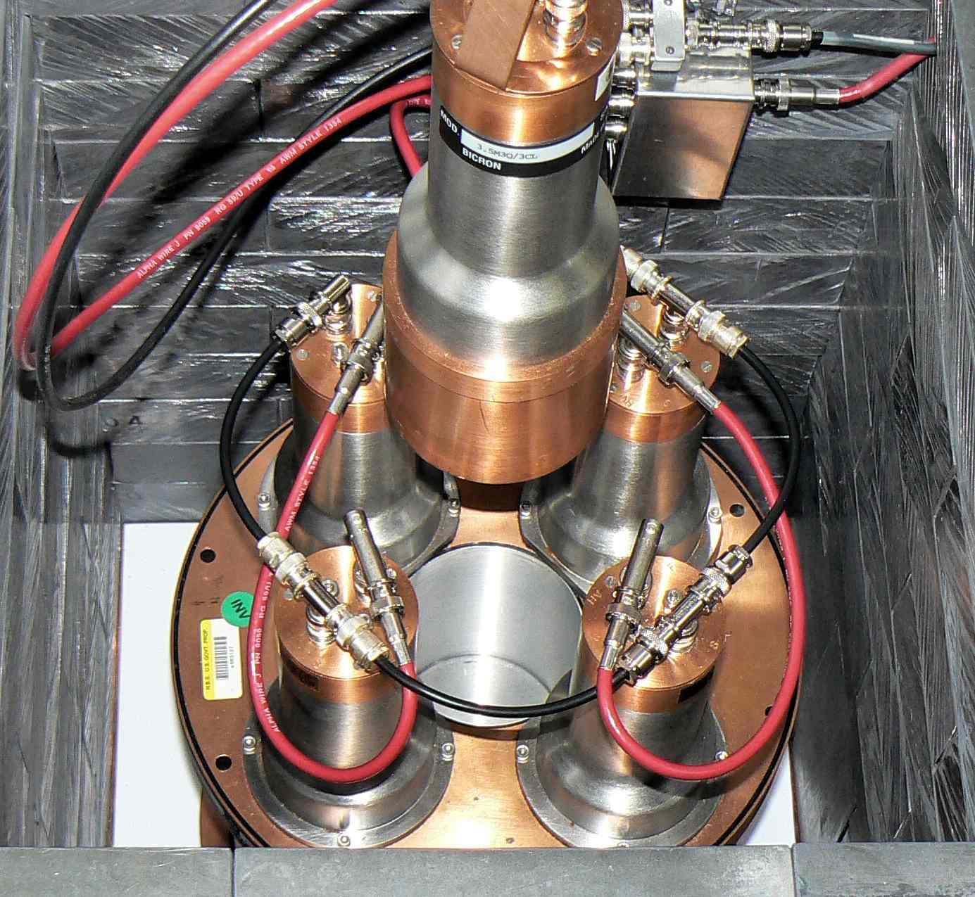
Anti-Compton
Surround Ge with NaI
Result: improved background
Notes:
We can use anti-Coincidence to remove background.
Of course, you are also attenuating your source.

Slide 2
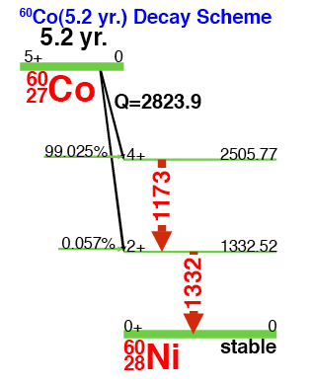
Detection limits (3-day count)
With Compton suppression
¹³⁷Cs is better 0.020 to 0.007 Bq
But ⁶⁰Co is worse 0.023 to 0.041Bq
Notes:
Just how good is the anti-Compton suppression? You can detect at very low levels.

Slide 3
Ge vs scintillator
“It has been shown that there exists some source intensity, l_{critical}, for which two compared detection systems [42 cm³ Ge(Li) vs. 7.6 cm x 7.6 cm NaI] yield identical precision for identical count time….Below this intensity, the Ge(Li) system always yields superior precision whereas above l_{critical} the Nal(TI) system is ascendant. This result is contrary to that expected using arguments based on counting efficiency considerations alone”
R. Robertson, N. M. Spyrou, and T. J. Kennett, Low-level Gamma-Ray Spectrometry: NaI(Tl) vs. Ge(Li), Anal. Chem. 47 (1975), 65-70.
Notes:
What is happening here is that the high-resolution detectors put more counts into a few channels, while the continuum background is spread over many.
NaI background at best 6% x 1333 = 80 keV, Ge 1.6 keV; 50x better. Thus a modern Ge with 50% efficiency (relative to NaI) will have detection limit = eff/sqrt(b) a factor of sqrt [50(resolution)*2(efficiency)]/0.5(eff) = 20x better

Slide 4
Ge vs NaI
Compare:
3x3 NaI, resolution R_{NaI} = 80 keV
Ge, efficiency ε = 50% of NaI, resolution R_{Ge} = 1.6 keV
For a background gamma field of G γ/s·keV

Slide 5
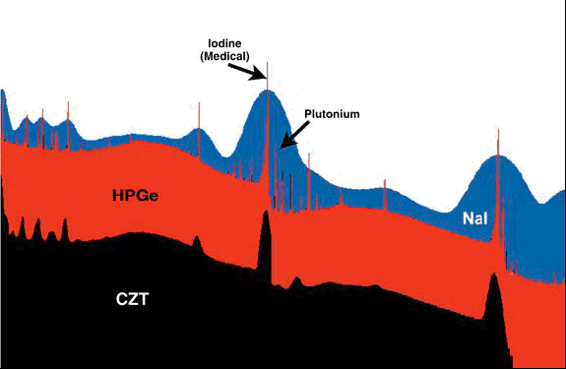
Detector resolution comparison
http://www.ortec-online.com/papers/sup_hpge.pdf

Slide 6
What is most important?
Efficiency?
Resolution?
Background?
Answer: yes

Slide 7
Part II
Covered during the second day of instruction.

Slide 8
Nuclear Smuggling
Nuclear smuggling involves the illicit trafficking of any nuclear or radiological materials
illicit nuclear trafficking: comprises the unauthorized acquisition, provision, possession, use, transfer, or disposal of nuclear and other radioactive materials whether intentional or unintentional and with or without crossing international borders
these material could be used by terrorists (or a rogue state) in the fabrication of a radiological dispersal devices (RDD) or an improvised nuclear device (IND)
In recent years there has been a growing awareness of illicit trafficking in nuclear materials
during the early 1990’s, several cases of trafficking in nuclear material, that could be directly used in nuclear weapons, raised concerns that such materials could be obtained by terrorists
concerns were greatly increased by the events of 9/11
Notes:
Self-explanatory

Slide 9
Combating Nuclear Smuggling
Deterring access to and availability of nuclear and other radioactive materials is critical to combating nuclear terrorist capabilities
Generally two types of programs:
secure nuclear weapons, nuclear materials, and other radioactive materials worldwide
detect and prevent illicit trafficking of these materials
Combating nuclear smuggling requires active and continual monitoring of
nuclear material facilities
border locations
smuggling organizations (organized crime)
countries of interest
Notes:
Self-explanatory

Slide 10
Type of Materials Smuggled
Nuclear Materials:
material that can be used for nuclear fuel or in the construction of nuclear weapons
uranium, plutonium, americium, neptunium, thorium
Radioisotopes:
radioactive isotopes used in industrial and medical applications
Cesium-137, Cobalt-60, Strontium-90, etc.
Dual-Use Materials:
materials that has both commercial and military or other strategic applications
tritium, lithium, beryllium, zirconium, etc.
Other Materials:
materials related to fraud (scam), containers, lead, etc.
Notes:
Here is a run down on (some of) the possible materials of interest.
We are obviously concerned with SNM and radioisotopes.
There are some legitimate reasons for shipment / transport of radioisotopes.
There are other things, like dual-use materials, that might hint at a clandestine weapons program.
For this lecture, we’ll focus on dection of the nuclear materials and radioisotopes.
What are we looking for?
Materials of interest that can be used in the production of a RDD or an IND
Other potentially harmful trafficking (contaminated / activated materials)

Slide 11
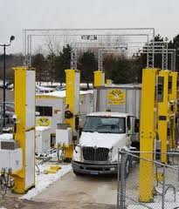
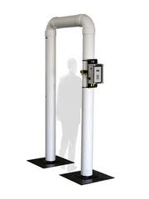
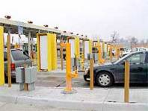
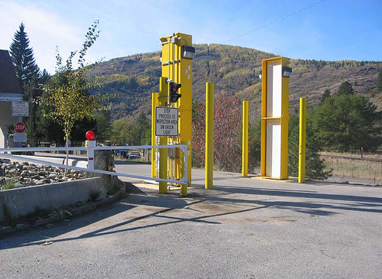
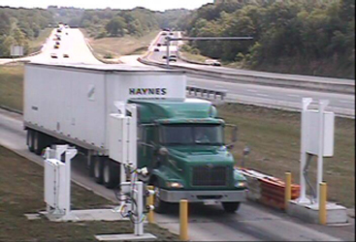
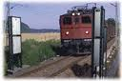
Mission of the Radiation Portal Monitors
Radiation Portal Monitors (RPMs) play a vital role in combating the illicit trafficking of radioactive material.
Borders
Port
Facilities
Notes:
Here is a picture of what some of the radiation portal monitors (RPMs) look like.
These systems play a vital role in our nation’s capability to detect and intercept illicit radioactive material entering our country.
These system will detect both innocent and illegal radiation sources.
In ports of entry innocent sources could be granite, toilet seats or even kitty liter. All of these sources are considered Naturally Occurring Radioactive Material or NORM.
These systems must be designed to detect these sources and also be able to distinguish between NORM and sources that might create a theat.

Slide 12
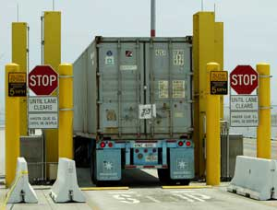
Radiation Portal Monitors on the Border
Typically fixed locations
Located at traffic choke points
Speeds should be reduced while passing through portals
Traffic controls
Detection Capabilities
Neutron
Gamma
How could the other portals react if you have a “strong” source in another lane?
Notes:
TRAFFIC CONTROLS – speed bump, gate, traffic light
Neutron detection: Currently in deployed portals
Answer: strong source in one lane can simultaneously set off portals in another. This can cause confusion.
What happens if a source very slowly moves toward the portal.
Background can slowly go up and may never trigger an alarm.

Slide 13
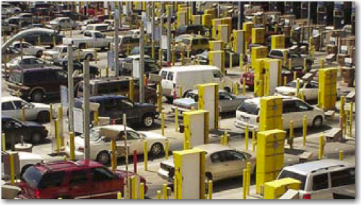

Radiation Portal Monitors on the Border
At San Ysidro (CA) border crossing alone, per day
50,000 vehicles
25,000 pedestrians
307 ports of entry in USA
621 border crossing (2002 data)
Over 300,000 vehicles, 2,500 aircraft,
and 600 ship pass through these ports every day
Main mission: intercept material
prior to crossing a border
Notes:
This slide shows you a rundown of all the traffic passing through our ports.
Any scanning method used needs to limit its impact on commerce.
In addition to all of this, the RPMs must:
(1) be designed to survive the environmental effects. Some problems:
Rapid decreases in temperature can damage (crack) NaI crystals
Polyvinyl toluene (PVT) is more rugged and less susceptible to environmental changes
Photomultipliers can drift (amplification can change) with increasing and decreasing temperature. This can affect alarm settings
(2) remain effective in a rough working environment
Notice that in the figures the portal monitors each have yellow-metal/concrete columns protecting them. This is to protect the detectors from being hit by vehicles.
Even so, portals are designed to with stand some level of impact
Additional packaging around the portal monitors can affect minimum detectable activities

Slide 14
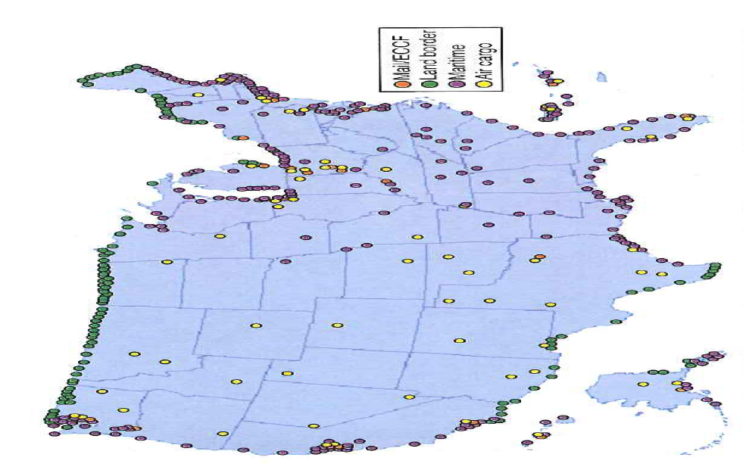
Radiation Portal Monitors on the Border
Notes:
As you can see, there are many, many points where we monitor what comes through the borders.
Of course, this only accounts for a very small fraction of our borders.

Slide 15
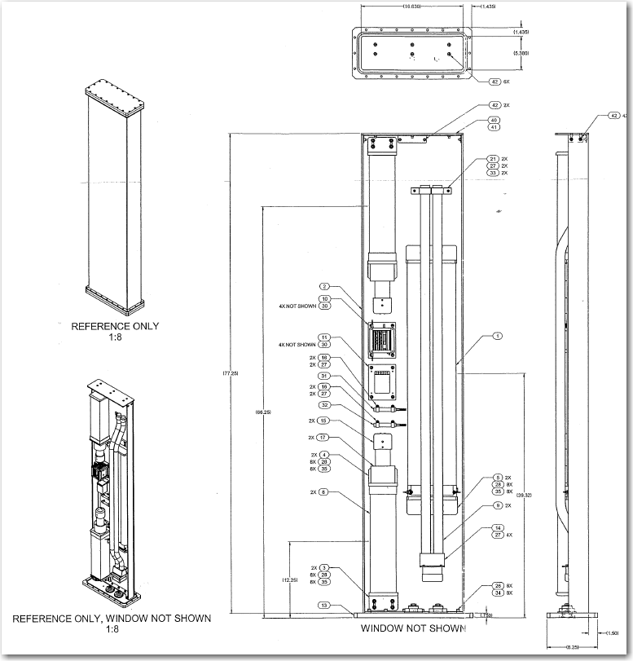
Typical Radiation Portal Monitors
Most portals will have at least gamma detection capability
NaI
PVT
Why would one be better than another?
Some will have neutron detectors
Typically associated with vehicle type portals
Notes:
Why would one be better than the other?
NaI resolution. PVT durability and large size.

Slide 16
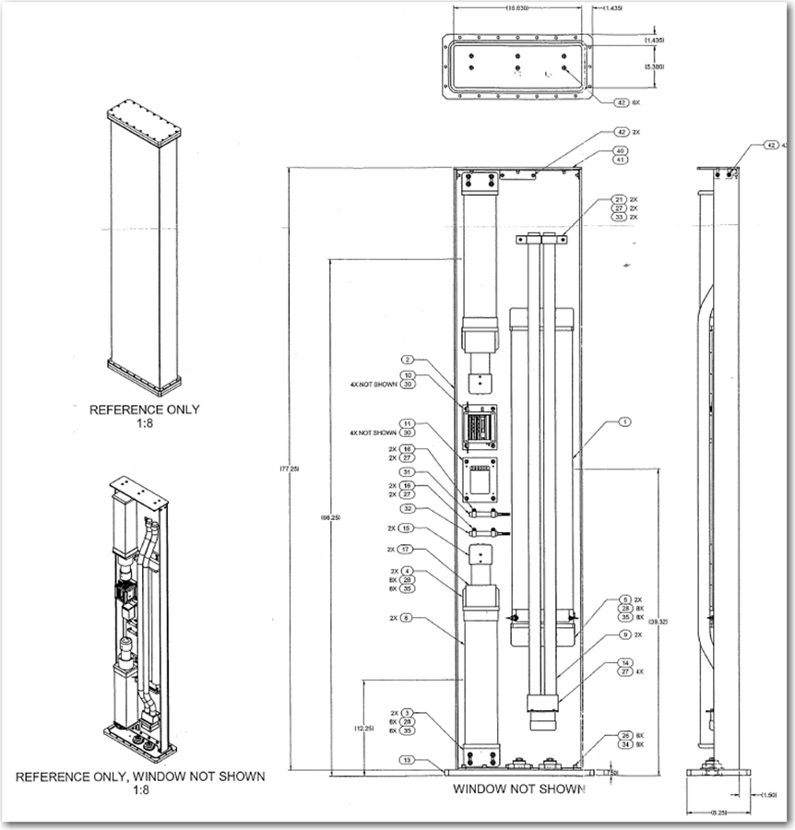
Typical Radiation Portal Monitor Design
NaI
Bars over the He-3
act as a layer of protection for the He-3 tubes
4 to 6 moderated He-3 tubes
NaI
Notes:
This is a typical mixed location RPM.
This system will have 2-4 in X4 in NaI in each side of the portal.
Also on each side will be a 4 - 6 moderated He-3 tubes for neutron detection.
The bars over the moderated neutron detectors acts as protection for the tubes. The systems could be struck by a vehicle. The bars will at least provide some protection.
The back of the portal is usually shielded with Pb or W to reduce background and interference from other lanes.

Slide 17
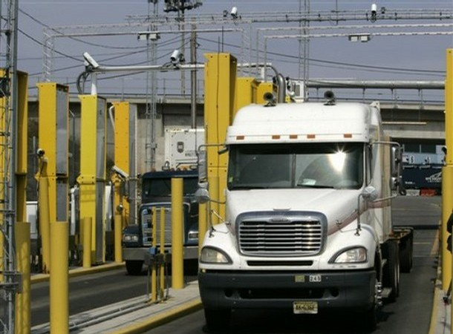
NaI(Tl) Detectors
Notes:
A picture of an RPM.

Slide 18
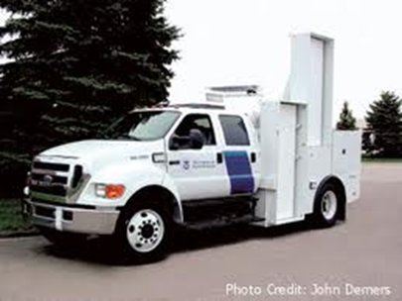
Specialized RPMs
Mobile RPMs
Advantages
Can set-up portal anywhere
Can be used in stationary mode or “mobile mode”
Typically used at seaports by Customs and Border Patrol (CBP)
Also appropriate for use at airports, rail yards, and vehicle cargo operations
Notes:
This system were designed by Butek, Inc.
DHS paid $20M for 200 hundred of these systems in 2006.
The first systems were deployed to the port of New York/New Jersey in May 2006.
This is not the only system available, just a representative sample.

Slide 19
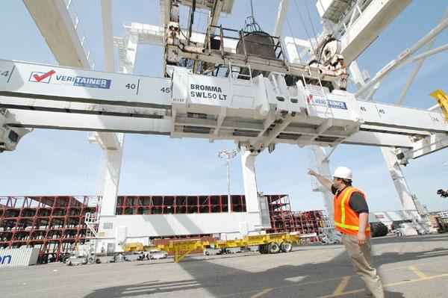
Specialized RPMs
Spreader-Bar crane mounted detection system
Advantage
If all cranes had this system, it would guarantee 100% cargo screened.
Better minimum detectable activities may be improved over land based RPMs
Pictured system has 32 NaI detectors and an array of He-3 tubes
Disadvantages
Only scans the top of the cargo container
Under great physical stress due to operation
Notes:
Pictured system as 32 NaI and an array He-3 tubes for neutron detection
This system would operate at almost 100 feet above the dock. This would reduce the background of the system compared to land based RPMs
By scanning only the top of the container you have significantly reduced “viewing” capability for sources at the bottom of the container. This problem is magnified with high Z cargo.
These system operate in harsh environments. Crane operators regular bang these around. Physical shocks of up to 50gs have been recorded.

Slide 20
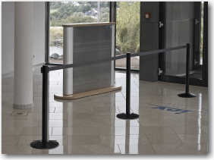
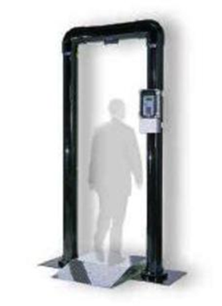
RPMs used in non-nuclear facilities
Verifying radioactive material does not enter an event or building is also important
These systems are placed at choke points and entrances to scan people as they enter
Notes:
A typical monitor for personnel.

Slide 21
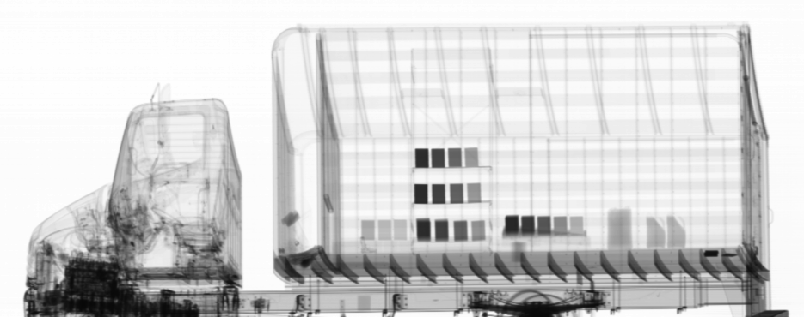
Dual-Energy Radiography (SAIC CAARS* 6 MeV / 9 MeV)
Conventional Radiography – SAIC CAARS, 9 MeV beam
Notes:
Dual energy bremsstrahlung spectrum.

Slide 22
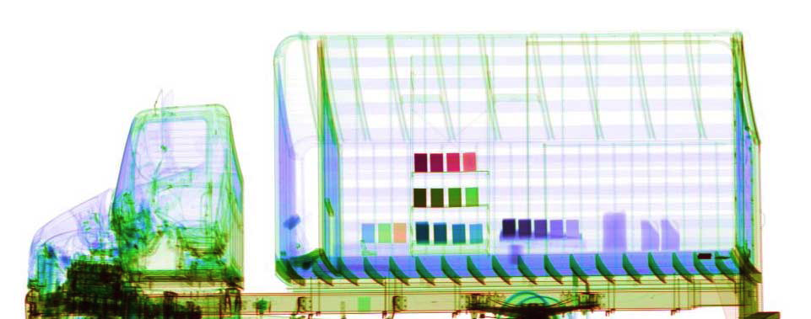



Dual-Energy Radiography with False Colors Assigned
High-Z
U
Pb
Cu
Fe
Al
Low-Z
Hand Gun
Drug Simulant

Slide 23
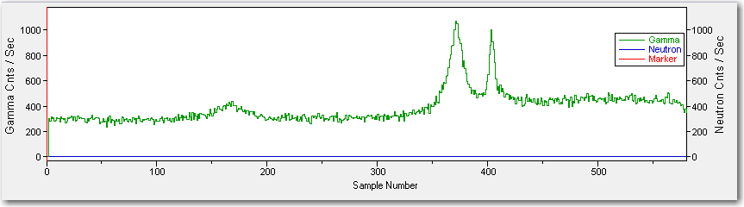
Setting Portal Monitor Alarms
View of a RPM display
The X-axis is time.
The Y-axis on the left side is gammas/sec.
The Y-axis on the right side is neutrons/sec.
Notes:
This is a display of what a portal monitor read-out might look like.
Notice between time = 0 to ~300 the background count is relatively constant. There appears to be a small broad peak around t=175.
What could cause the broad peak?
A vehicle, possibly with a small or shielded source, moving slowly toward the detectors. You could imagine this happening at a border crossing.
The large peaks are for sources passing through the portal.
All 3 of the peaks could set off alarms
A RPM continuously monitors radiation readings regardless if a vehicle (or person) is present
How can you set the alarm level?
Alarm levels are set based on this background reading
Using the Standard Deviation. The standard deviation of the background is calculated. If the count rate exceeds some multiple of the background standard deviation or some multiple of background count rates an alarms is triggered
A portal could also be set to trigger when some multiple of the background count rate is exceeded For example, the alarm threshold is set for 2X background. From the previous example, the threshold would be 600 s⁻¹. This technique is not as sensitive as the standard deviation method
Setting the best threshold is important
The threshold should be sensitive enough to register illicit cargo, but not so sensitive that it alarms due to statistical fluctuations in background or slightly elevated NORM readings in legitimate cargo
False alarms can have an affect on response force. When the alarm goes off, someone has to check it.
Other types of alarm algorithms attempt to differentiate “real” alarms from “nuisance” alarms.
You may also be looking at energy windows rather than the whole spectrum.

Slide 24
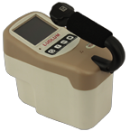
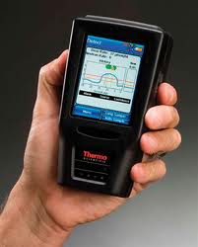
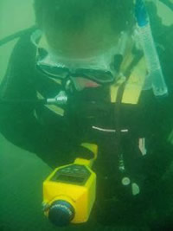
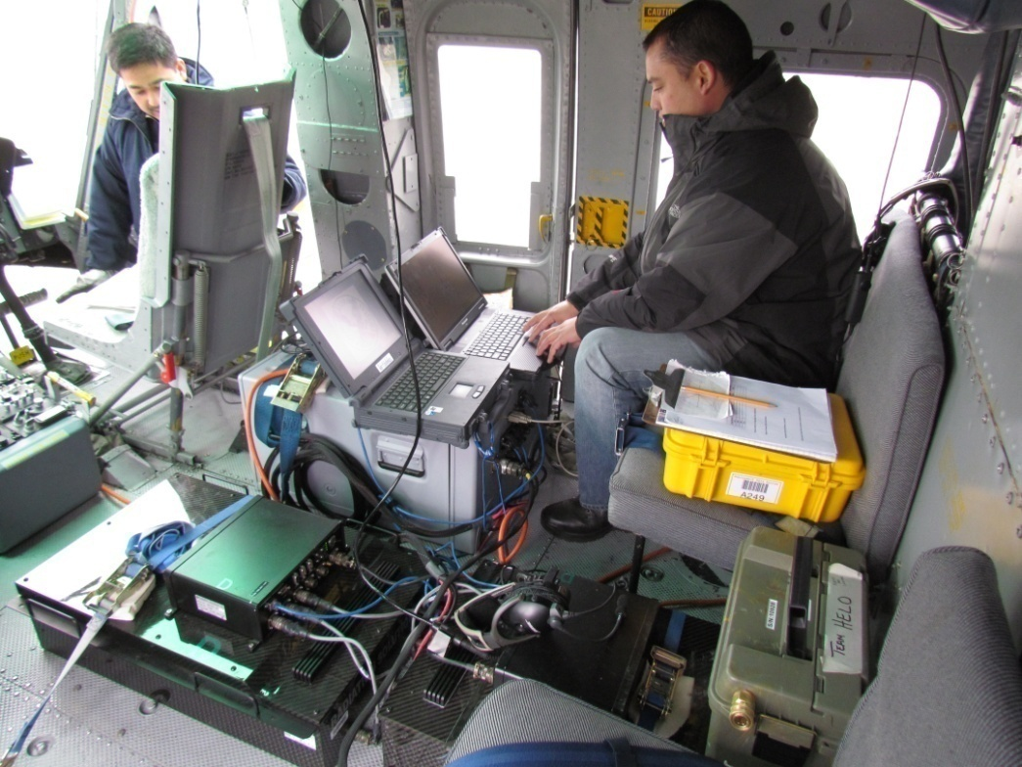
Portable Radiation Detection Systems
Field deployable systems are those detection systems that can be carried into the field by law enforcement or response teams
They can be carried by:
Individuals
Ground vehicles
Aircrafts
Boats
Notes:
The pictures are merely examples of different deployable systems. The Identifinder has a version that can be used underwater.
The picture in the lower left is of the Radiation Solutions Inc RS-500 being used on a helicopter. The picture was taken during the DOE response to the Fukushima accident.
We previously looked at portal monitors. Can you describe some differences between RPMs and portable systems?
RPMs
Generally at a fixed location
Alarms when thresholds are exceeded
Limited ID capability (ASP)
Limited Localization capability
Large heavy systems
Portable systems
Can localize where radiation is being emitted
Can be used to ID gamma emitting nuclides
Mission flexible

Slide 25
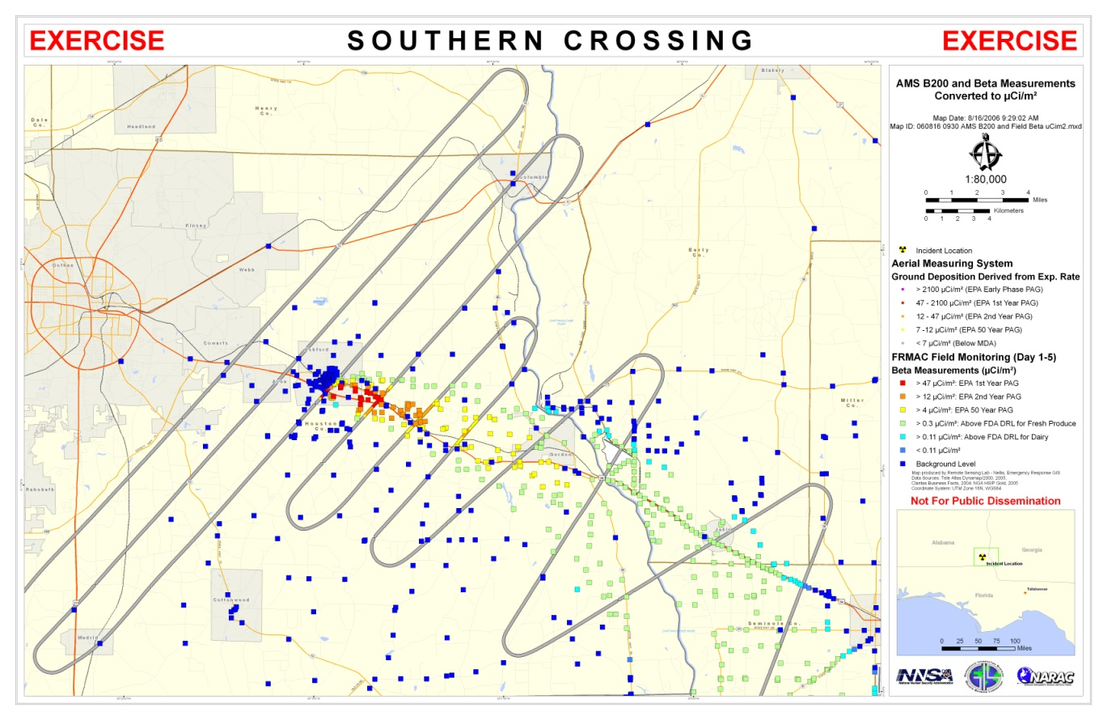

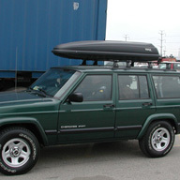

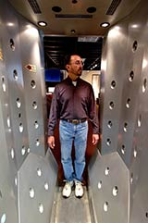
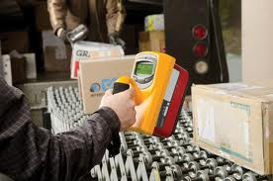
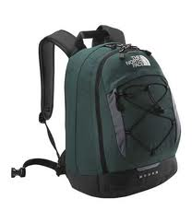
Portable System Mission Considerations
Overt versus low profile
Handheld
Man portable
Vehicle based
Ground
Water
Air
Notes:
Mission for Portable systems:
Portable systems work in conjunction with each other.
Vehicle systems are large and will indicate that a source is near
Handheld systems can then be used to find the location of the source but they often have limited ID capability
Specialized detectors, such as HPGes are used to positively ID the source
Field deployable systems can be used in different types of scenarios. Some detectors are very obvious while other can be concealed. It all depends on what you, as the user, are trying to accomplish.
Lastly, cost is also an issue. No enforcement agency has unlimited funds. The more specialized equipment is typically the most expensive. Also even after these detectors are bought, they require annual maintenance (characterization, calibration). Also, they must be repaired if they are broken. These types of unplanned for expenses can add up.

Slide 26
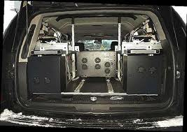
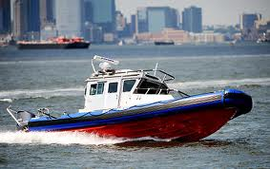
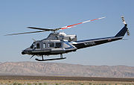
Mobile Systems
Mobile radiation detection systems are mounted to, and operate within a moving or stationary vehicle for the detection, identification, and quantification of radioactive material
These systems can be used in multiple platforms
Land Vehicles (car, van)
Aircrafts
Boats
Notes:
These picture were pulled from the internet
These happen to show all custom systems. The top photo is designed by Raytheon. The helicopter system is a custom made system for the DOE. The fuel pod on the side is carrying six 2”x4”x16” NaI detectors. The helicopter can hold as many as twelve detectors.
While the systems can be used interchangeably on different mobile platforms, the environment in which they are used drives how they are designed.
Aircraft systems must pass specific FAA requirements. For instance, if they start to burn (let’s say from a short) it will not emit toxic gases. How it is mounted on the aircraft must meet certain FAA requirements. Mounts must be able to survive specific g-forces, so that they do not become loose in a crash.
Boat systems must be water resistant and survive the marine environment. Saltwater can play havoc with electronics. Untreated metals will corrode.
There are no safety and environmental hardening requirement for car systems.

Slide 27
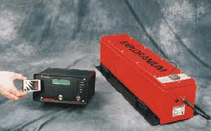
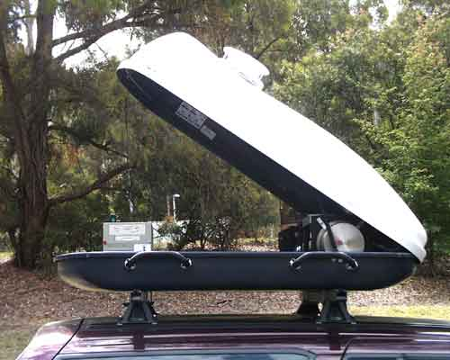
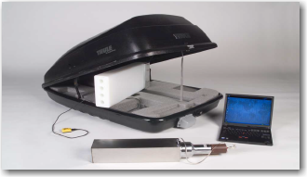
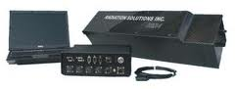
Mobile Systems
Very Similar to RPMs
Characteristics
Large scintillation detectors
Most are NAI up to 4”x4”x16”
Neutron detection
Many have He-3 tubes some companies are experimenting with Li-glass
Alarm algorithm are based on count rate.
Notes:
Exploranium, Thermo, ORTEC and Radiation Solutions Inc, all make vehicle carried radiation detection systems.
The luggage carrier in the left middle is the Australian government's system.
The picture was taken from the Australian Radiation Protection and Nuclear Safety Agency website.
The luggage carrier to the right is the ORTEC mobile system, and it has 1-4”x4”x16” NAI detector and 4- 2”x3’ He3 tubes.
You can see the poly-block where the tubes and encased are in the picture. (Picture from SAVER Technote on Mobile detection systems)
They are all trying to find radiation sources while traveling at speed.
Therefore they must have large detectors to increase their detection efficiency.
The detector sizes are very similar to those found in RPMs.
NaI is almost exclusively used by these systems, because they will not be subject to the weather extremes of RPMs and the NaI gives limited ID capability.

Slide 28
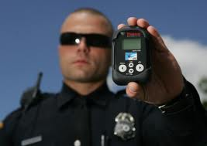
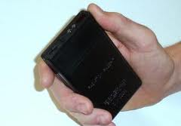
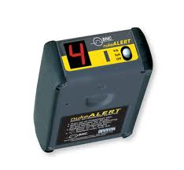
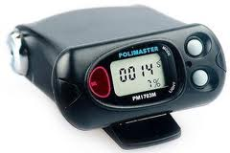
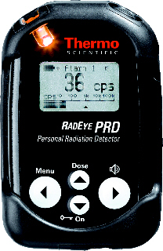
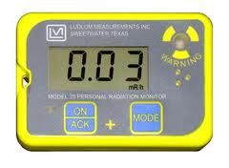
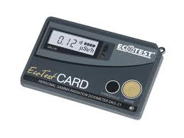
Radiation Pagers
Radiation pagers are extremely small detection devices that can be worn on a belt
Worn extensively by law enforcement
Police, FBI, Customs
Fire
Audible and/or vibration alarms alert the wearer of radiation near by
Notes:
Pagers are not a primary search instrument. Pagers are meant to alert the wearer that a radiation source is nearby.
Radiation pagers are designed to respond only to highly penetrating ionizing radiation (gamma or neutrons) and can not detect alpha or beta radiation.
Some law enforcement will wear these during their normal duties instead in response to intelligence driven information.
If elevated levels of radiation are noted, law enforcement will execute their protocols to investigate the source.
These protocols are jurisdiction dependent and will not be discussed here.
They can often be powered by normal AA batteries

Slide 29
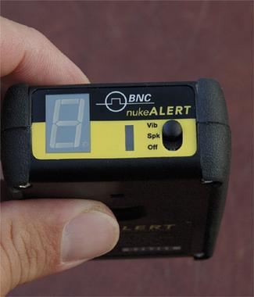

Alarms and Readouts
Readouts
Very simple, mostly without any units
Dose units (mSv/hr, mrem/hr. . . )
Counts/sec
Alarms
Preset and user defined
Avoids false positive, but also know when you are in an area of concern
Notes:
The first pager (top) is the “nuke Alert” from Berkeley Nucleonics.
In the presence of excess radiation, it gives a number of 1 through 9.
Each number represents an exposure rate: 1= 0.035 mrem/hr and 9=1.1 mrem/hr.
It will also produce an “H” value if the radiation field exceeds 13 mrem/hr.
This pager is targeted to untrained users who are not used to radiation units (and frankly don’t care).
They understand the higher the number the higher the radiation field. “H” means get out of the area ASAP.
The other 2 pagers are examples of pagers that give readouts that trained users can comprehend and make decisions from.
Data is also stored on these so it can be used to provide dose reconstruction results for responders.
The Polimaster pager in the center claims to have ID capability.
It has a library of about 30 nuclides including SNM
If the pagers can detect neutrons, the neutron data is listed in cps.
Alarms are set by a qualified user at levels that are jurisdiction dependent.
For gamma rays these alarm thresholds are in units of exposure/dose rates. Neutron alarms are based on cps.

Slide 30
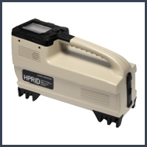
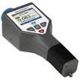
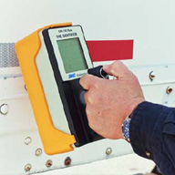
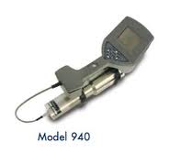

What are RIIDs?
Small, portable, (handheld) radiation detectors
Has visual and audible indicators to alert a user
All have the ability to identify gamma emitting radionuclides and report that identity to the user
Spectra can be recorded and downloaded to a computer for further analysis
Notes:
When radiation sources are detected by screening devices, (RPM, mobile detectors or pagers) RIIDS are used to identify the location of the source and the radionuclide emitting the gamma radiation.
About identification: RIIDS have limited libraries.
The software can identify a peak or peaks of a specific nuclide in the library.
If a source is unknown, the spectra can be downloaded to a computer and analyzed with spectrum analysis software such as GENIE 2000 or GammaVision.

Slide 31






Hand-Held Detectors

Slide 32
Standard Features of a RIIDs
Battery powered (usually battery life can vary by RIID)
Built in spectral analysis software for real time ID
Isotopes are separated into 4 groups
Industrial
Medical
Special Nuclear Material (SNM)
NORM
Some have neutron detectors - aid in the ability to detect SNM
GM tubes or scintillation detectors that are used to indicate if the user is approaching a high radiation field
Notes:
Examples of industrial–weld inspection civil engineering, food irradiators. Cs-137, Co-60, Ir-192. . .
Medical– used in radiotherapy and medical imaging (Tc-99, I-131…).
As a special note, these used to be unable to identify PET isotopes like F-18.
It would only see the 511 peak and be unable to ID.
SNM– Pu, HEU, Np, material that could be used to make a nuclear weapon
NORM– in commercial products like ceramic and fertilizers: K, U-series, Th-series, Ra

Slide 33
Considerations when Choosing a RIID
Size
Weight
Battery life
Ease of use in the field
Ease of electronically uploading spectra for further analysis
Ease of shipping
Cost – a function of all of the above
Notes:
Size – do you want something small or does size not matter to you
Weight – if it is too heavy, it becomes a pain to use especially if you carry it all the time
Battery life – will it be plugged into a docking station between uses or will you be out in the field for long periods of time? Longer battery life cold also necessitate larger batteries which can mean more weight
Ease of use in the field- Does an operator only need to “point and shoot” or does it require significant training to use and understand?
Ease of shipping- some of these RIIDs have implanted radiation sources or have neutron tubes at high pressure. These are sometime considered HAZMAT and special shipping rules must be followed
RIID can cost anywhere from a ~$10k to $100k depending on your needs. Maintenance cost is also something to consider

Slide 34
Performance Considerations When Choosing RIIDs
Sensitivity
ability to detect and measure the radiation of interest in the presence of noise and signals caused by other radiation
Efficiency
intrinsic efficiency
fraction of particles striking the detector volume that are detected
geometric efficiency
solid angle that the detector presents to the source
absolute efficiency
product of geometric and intrinsic efficiencies
Energy Resolution
accuracy with which the system can measure the energy of a radiation, and its ability to distinguish radiations of slightly different energy

Slide 35
References
Low background
R. M. Lindstrom, D. J. Lindstrom, L. A. Slaback, and J. K. Langland, A Low-Background Gamma Ray Assay Laboratory for Activation Analysis, Nucl. Instrum. Methods A299 (1990), 425-429.
G. Heusser (1993), Background in Ionizing Radiation Detection - Illustrated by Ge-Spectrometry, Proc. 3rd Internat. Summer School on Low-Level Measurements of Radioactivity in the Environment: Techniques and Applications, Huelva, Spain, World Scientific, Singapore.
Figure of merit
J. A. Cooper, Factors Determining the Ultimate Sensitivity of Ge(Li) Gamma-Ray Detectors, Nucl. Instrum. Methods 82 (1970), 273-277.
R. Robertson, N. M. Spyrou, and T. J. Kennett, Low-level Gamma-Ray Spectrometry: NaI(Tl) vs. Ge(Li), Anal. Chem. 47 (1975), 65-70.
R. M. Lindstrom, High-Sensitivity Gamma-Ray Counting in Activation Analysis, Appl. Radiat. Isotop. 43 (1992), 263-269.

Slide 36
References
Title Picture credit: http://cdsweb.cern.ch/record/1345733
J. R. Lamarsh, “Introduction to Nuclear Engineering”, 2nd ed., Addison-Wesley,
Reading, MA (1983).
J. K. Shultis and R. E. Faw, “Fundamentals of Nuclear Science and Engineering”,
Second Edition, CRC Press, 2007.
S. Lehar, “An Intuitive Explanation of Fourier Theory”, Boston University.
http://cns-alumni.bu.edu/~slehar/fourier/fourier.html
Wikipedia, Pinhole camera
Jean in 't Zand, “Coded aperture imaging in high-energy astronomy”, NASA Goddard
Space Flight Center, http://astrophysics.gsfc.nasa.gov/cai/
“Imagers Provide Eyes to See Gamma Rays”, LLNL Science and Technology Review,
May 2006

Slide 37
References
“Radiation detection on the front lines”, LLNL Science and Technology Review,
September 2004
D.M. Smith, G.J. Hurford, and S.E. Boggs, “Rotating modulation collimator imagers”,
New Astronomy Letters 48, 209-2013 (2004).
NASA RHESSI Imager, http://hesperia.gsfc.nasa.gov/rhessi2/
R. Orito, et al. “Compton gamma-ray imaging detector with electron tracking”,
Nucl. Instrum. Methods A 525 107–113 (2004).
L. Mihailescu, et al., ”Standoff 3D Gamma-Ray Imaging” IEEE Trans. Nucl. Sci. 56, 479 (2009)
K. Ziock, et al., ”The Use of Gamma-Ray Imaging to Improve Portal Monitor
Performance”, IEEE Trans. Nucl. Sci. 55, 3654 (2008)
H. Yamanishi, ”Design of a portable directional neutron source finder”, Nucl. Instrum.
Methods A 544, 643 (2005)

Slide 38
References
N. Mascarenhas, et al., ” Development of a Neutron Scatter Camera for Fission
Neutrons”, 2006 IEEE Nuclear Science Symposium Conference Record
I. Jovanovic, M. Heffner, L. Rosenberg, N. S. Bowden, A. Bernstein, D. Carter, M. Foxe,
M. Hotz, M. Howe, A. Myers, and C. Winant, “Directional Neutron Detection Using a
Time Projection Chamber,” IEEE Transactions on Nuclear Science 56, 1218-1223 (2009)
N.S. Bowden, M. Heffner, G. Carosi, D. Carter, J. Mintz, M. Foxe, and I. Jovanovic,
“Directional fast neutron detection using a time projection chamber,”
Nuclear Instruments and Methods in Physics Research A 624, 153-161 (2010)
S. Ahlen, D. Dujmic, P. Fisher, A. Inglis, H. Tomita, H. Wellenstein, ” A Background-Free
Direction-Sensitive Neutron Detector”, Nucl. Instrum. Meth. A 608, 305 (2009)
W. Mengesha, ” Modeling of a Directional Scintillating Fiber Detector for 14 MeV
Neutrons”, IEEE Trans. Nucl. Sci. 53, 2233 (2006)
Detector Resolution Comparison, http://www.ortec-online.com/papers/sup_hpge.pdf

